Slide 1
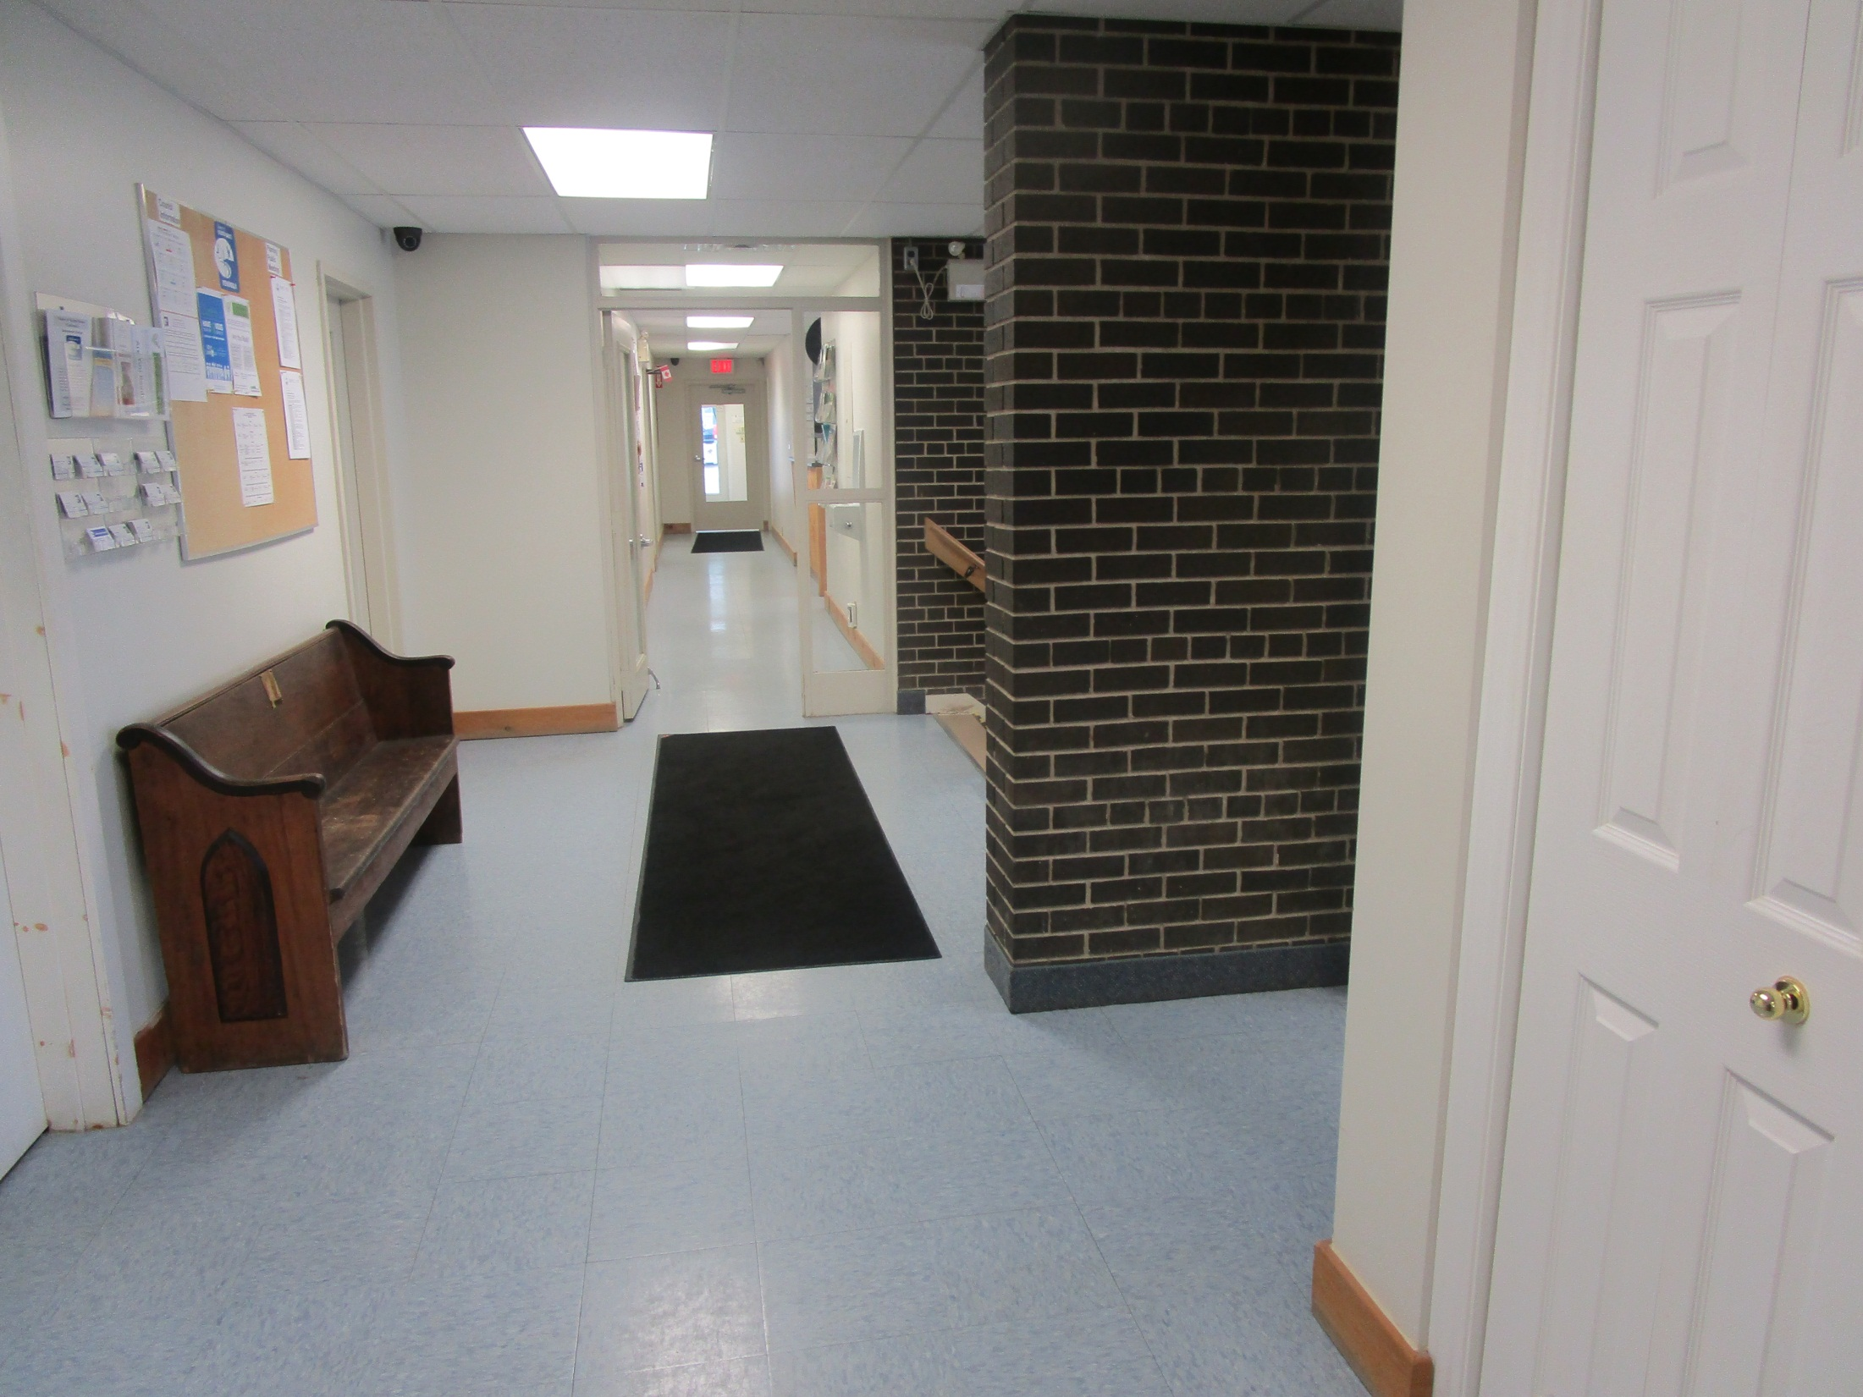
View of security camera (black hemisphere hanging from ceiling upper left) from building department

Slide 2
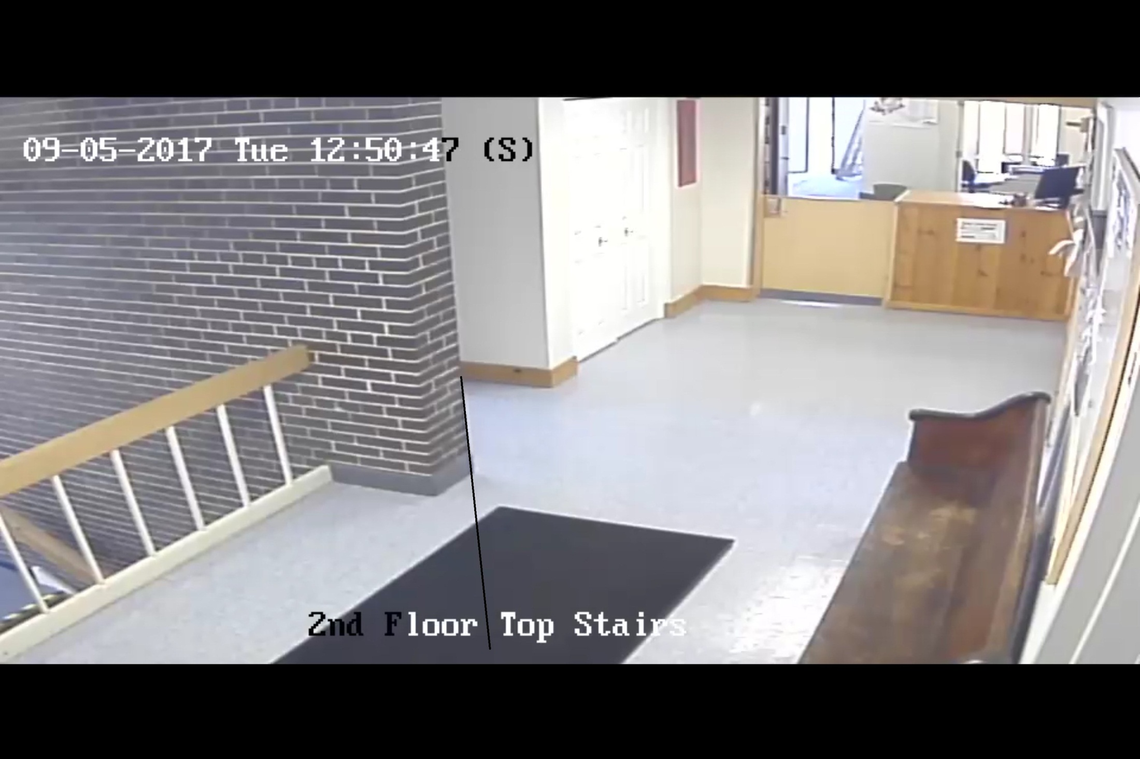
Still from security video

Slide 3
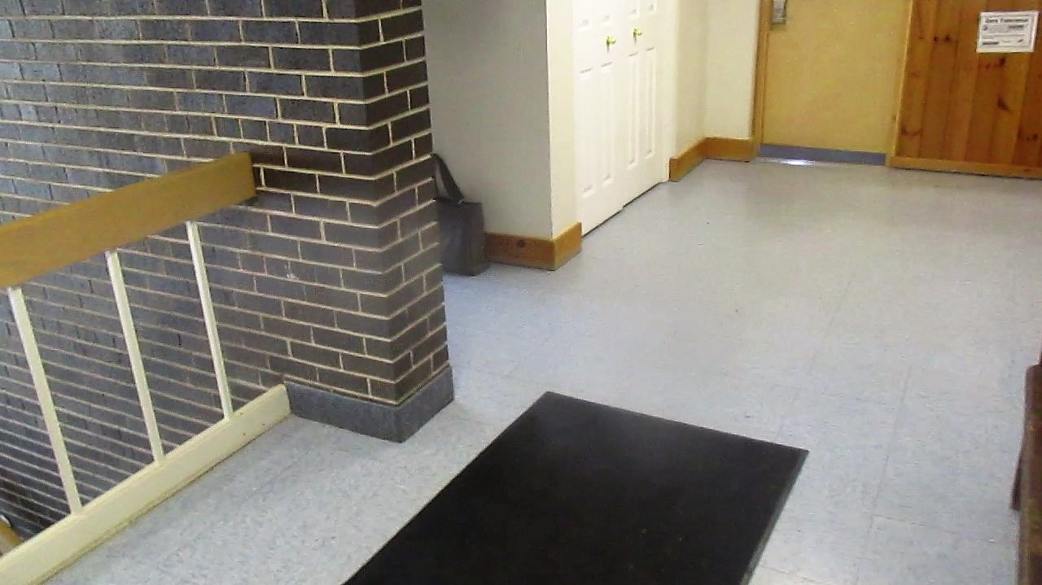
Picture taken from right below security camera

Slide 4
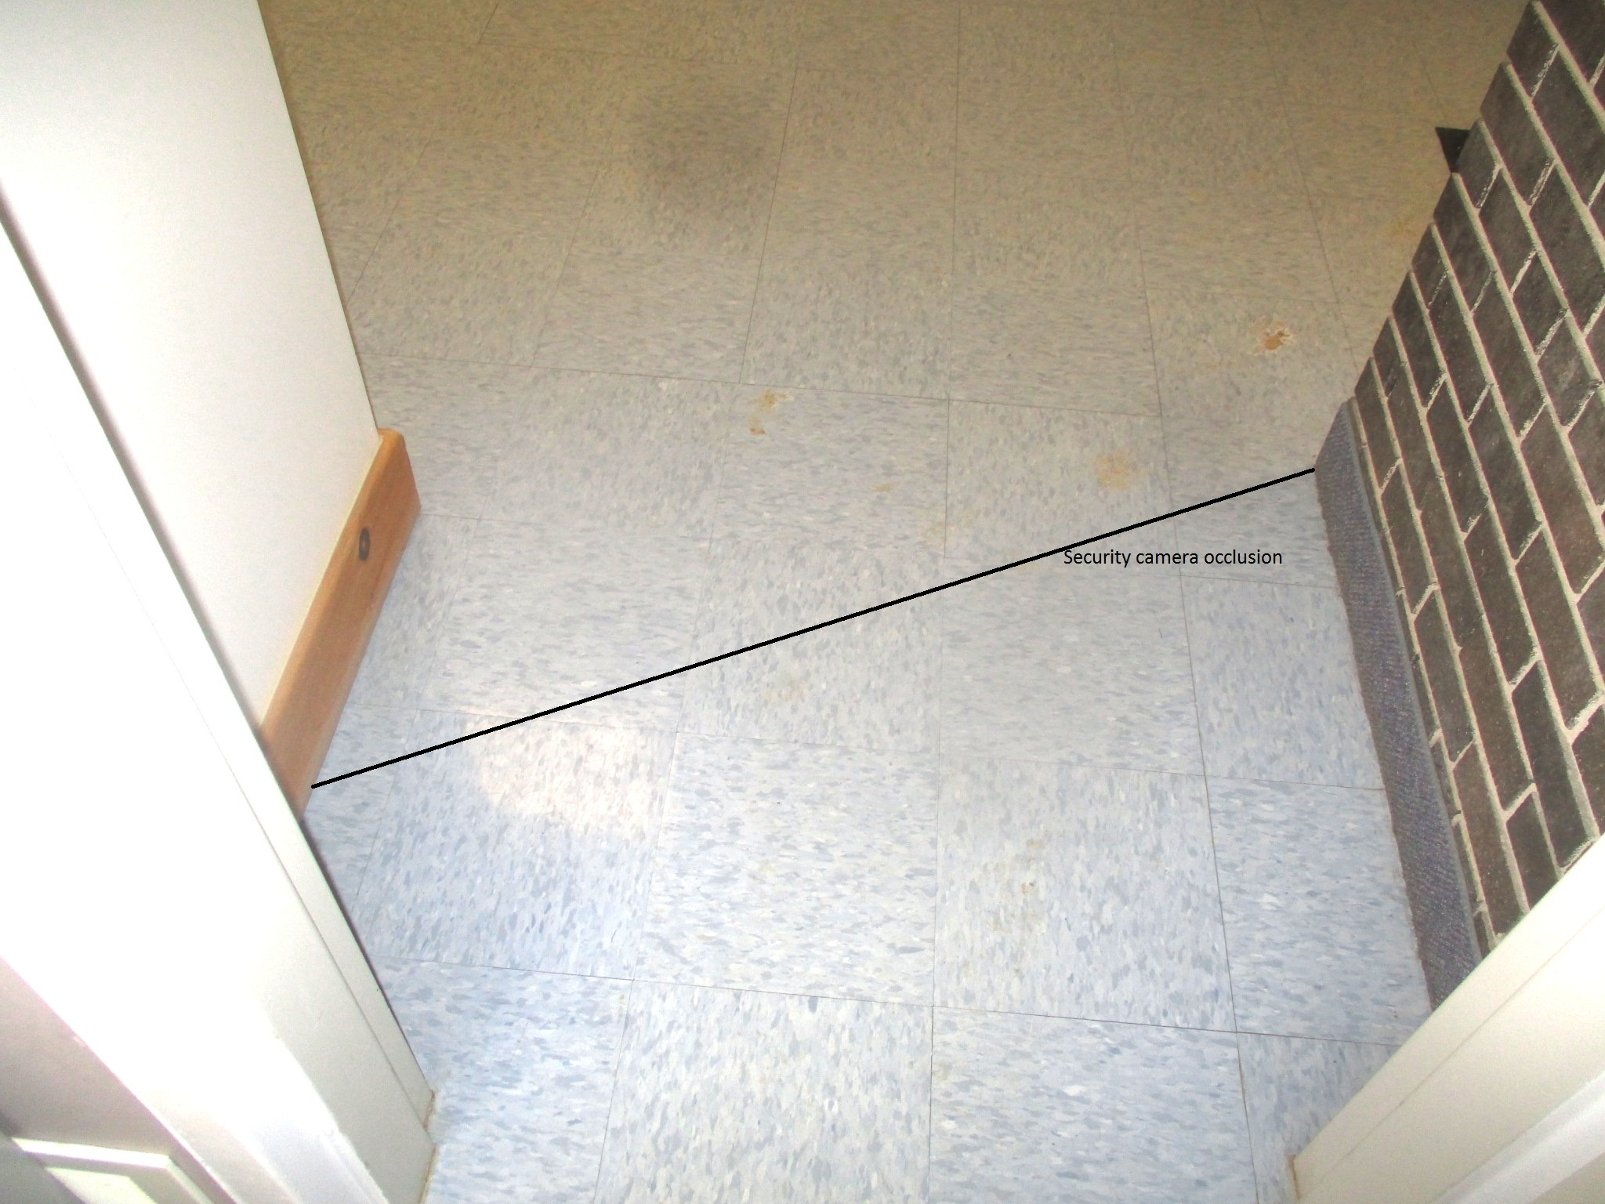
Floor tiles one foot by one foot
Clerks office door

Slide 5
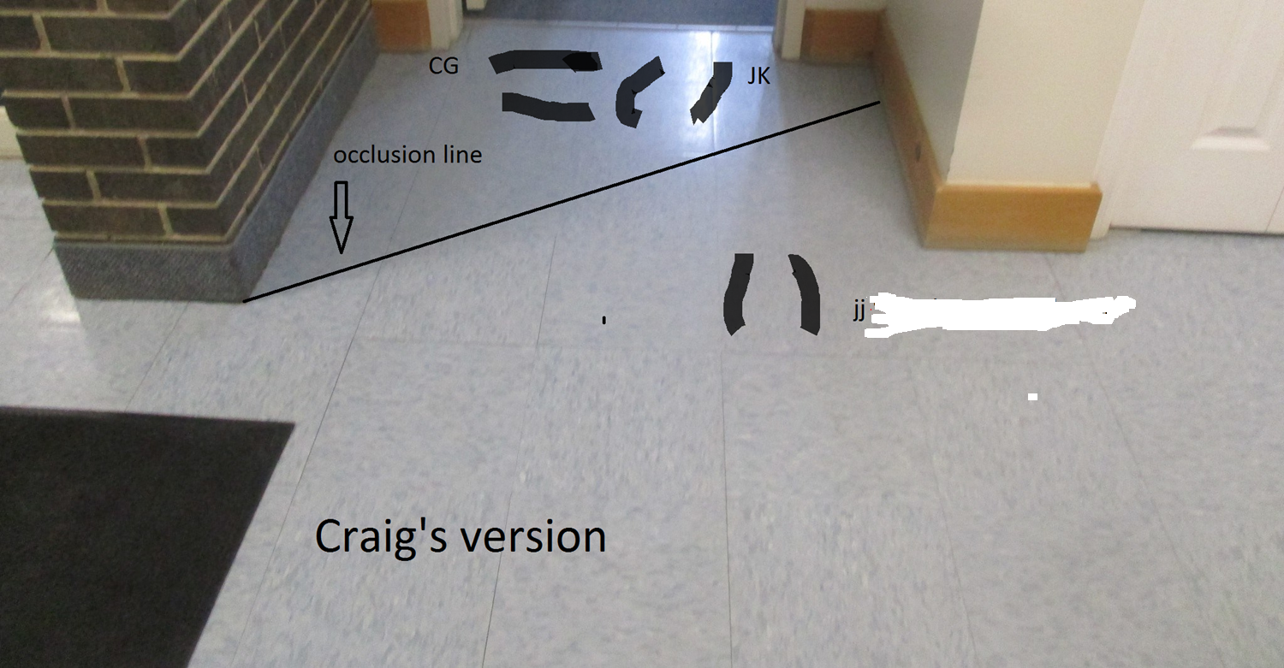

Slide 6
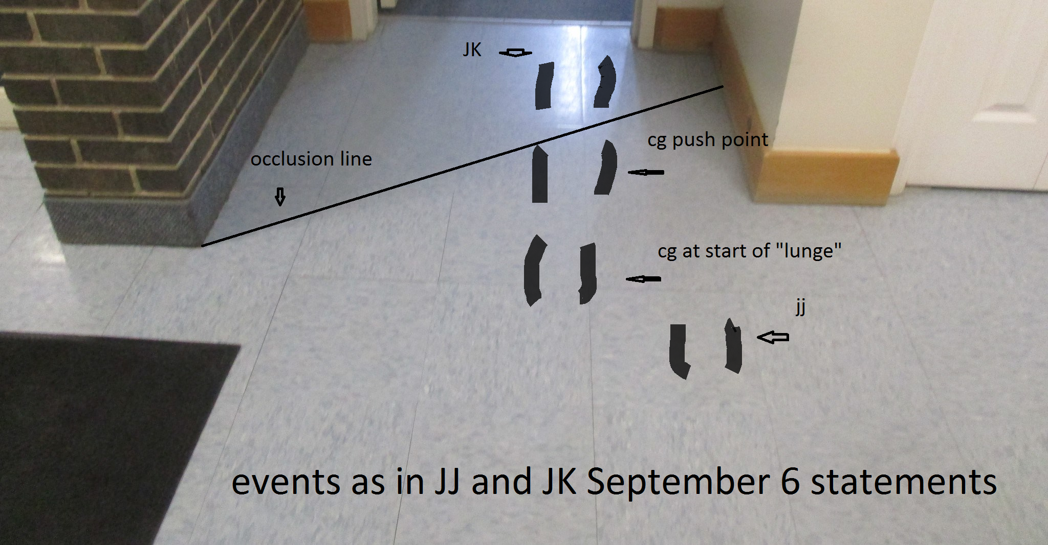
View of floor outside Cathrae office – view from south
And Janice Jackson December 7 2017 testimony

